Slide 1
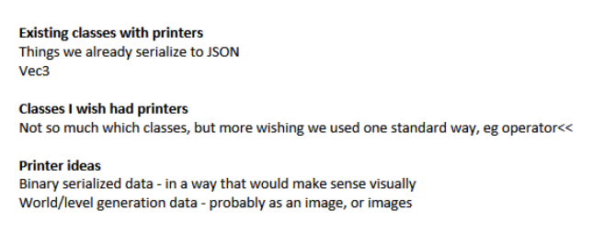
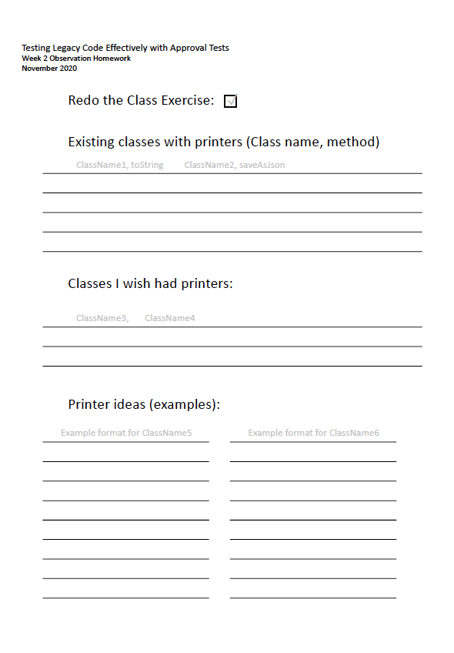
Redo this exercise by yourself, on your own computer
* I learned that in c++ it seems to matter that I have to declare a method above it's first call site
std::string runEverything(double input) {
TrigMath math;
std::stringstream strb;
strb << math.Sin(input);
return strb.str();
}
TEST_CASE("ApprovalTest everything")
{
Approvals::verify(runEverything(1.0));
}
works
TEST_CASE("ApprovalTest everything")
{
Approvals::verify(runEverything(1.0));
}
std::string runEverything(double input) {
TrigMath math;
std::stringstream strb;
strb << math.Sin(input);
return strb.str();
}
doesn't work.
I didn't expect that :)
* found a efficient way (in CLion) how to quickly build the runEverything method.
* Probably due to my lack of c++ knowledge, but copying from https://approvaltestscpp.readthedocs.io/en/latest/generated_docs/TestingCombinations.html?highlight=CombinationApprovals didn't work out of the box for me.
CombinationApprovals::verifyAllCombinations([&](auto input) { return math.Sin(input); }, inputs);
the copied snippet didn't have an & inside the [] before (auto input) and CLion complained.
Take notes around printing
* Existing: What did you find to display data as text? * serialize objects to json/xml
* call object's toString(). in java: List Set and Map (at least for primitives) work out of the box
* write your own toString() or printer like we did for runEverything()
* Classes: Which objects would benefit from a printer? * a Dice class could have a cool printer that prints ascii art
______
| * *|
| * |
| * *|
______
something like this ;)
* Money objects should have a printer that prints the amount + currency
* MSISDN class to print phone numbers in a uniform way
* Thinking about https://github.com/jlangr/name-normalizer then also a class representing a Name should have a good printer to print the name out again

